Slide 1





CHARGING UP CHANGE!
Black Country Network
Network Manager
JOB DESCRIPTION & SPECIFICATION
DEADLINE: 19th March 2026

Slide 2
JOB SUMMARY
NETWORK MANAGER
(BLACK COUNTRY NETWORK)
Deadline: 19th March 2026
Apply here: https://poweredbycan.uk.deputy.com/jobs#/
ROLE | Network Manager (Black Country Network)
REPORTING TO | Head of Partnership, Performance & Policy and Chief Executive Officer
RESPONSIBLE FOR | Network Members, Partners, Stakeholders
SALARY | £35,027 per annum
HOURS | Full-time (40 hours per week)
DURATION OF CONTRACT | Fixed Term until March 2030
TIMESCALE | April 2026
BASED | PBC HQ – West Bromwich
ROLES AVAILABLE | 1
SUMMARY | The Network Manager will provide strategic leadership and operational management of the Black Country Network , supporting a diverse, self- and community-led network of organisations and changemakers working with children, young people and young adults (under 35). Charging Up Change is a place-based initiative strengthening collaboration across the Black Country to address inequality, amplify youth voice and enable long-term systems change. Bringing together VCSE organisations, cultural partners, public bodies, funders and decision-makers, the network improves alignment, shared learning and collective impact. Acting as a connector and convenor, the Network Manager will embed youth voice, rights-based practice and collective action, ensuring the network delivers measurable social, cultural and civic impact.
by
Powered by CAN – Recruitment Pack| www.poweredbycan.org

Slide 3




WHO
WE ARE
POWERING CHILDREN, YOUNG PEOPLE
& YOUNG ADULTS TO CHARGE UP CHANGE!
by
Powered by CAN – Recruitment Pack | www.poweredbycan.org

Slide 4

OUR STORY
How we got here….
Powered by CAN works with children, young people and young adults across the Black Country and the wider Midlands region. Powered by CAN was created, built and developed in Sandwell, and we want to empower young people from the region to feel the same pride and purpose for their community as we do.
Children, Young People & Young Adults are at the heart of everything we do, and we make sure that we always put them first by ensuring we:
Champion their rights to co-design, co-create and co-produce and make their voices heard.
Encourage leadership pathways for their views and voice to be present their local community.
Kick start personal and professional development through a wider offer of experiences and opportunities.
We believe in providing opportunities for children, young people & young adults and we want to support them to thrive and contribute at every stage of their lives, for a fairer future.
HARNESSING YOUR…
POWER, POTENTIAL, PROGRESS
by
Powered by CAN – Recruitment Pack | www.poweredbycan.org

Slide 5


OUR MISSION
OUR VISION
How we can work together to make a difference…
We want to power up children, young people & young adults to live with pride, purpose and
prepared to make positive life choices.
How we can make the change…
Powering children, young people & young adults to lead the change they want to see through the delivery of services, opportunities & experiences that contribute at every stage of their lives, for a fairer future.
OUR VALUES
These are at the centre of everything we do…
CARE
CHALLENGE
COMMITMENT
COLLABORATION
CREATIVE
COMMUNITY
by
Powered by CAN – Recruitment Pack | www.poweredbycan.org

Slide 6





OUR SERVICES
Celebrating culture & civic responsibility through confidence, creativity & connecting with others…
Promoting positive lifestyles and empowering people through participation…
Navigating the narrative…
Always aiming high, aspiring to achieve & accelerating your ambitions …
Taking the time to talk, tackle & transform into our true selves…
by
Powered by CAN – Recruitment Pack | www.poweredbycan.org

Slide 7


OUR OBJECTIVES
1
Pride of Place
To develop collective understanding and knowledge on the identity of place to strength the services that are relevant to meet the needs of children, young people & young adults.
2
Positive Programmes & Principles
To deliver ambitious and high quality opportunities and experiences for children, young people & young adults and strengthen best practice for the sector to meet soft, hard and transferable skills.
3
Powering Participants & People
To build on the strengths and needs of children, young people & young adults to thrive and be resilient into adulthood.
4
Pushing Performance & Policy
To influence policy and investment to prioritise services for children, young people & young adults.
5
Playing our Part
To ensure our workforce, volunteers, board, volunteers are dynamic, diverse and driven to be reputable, responsive and represent a rights-based approach for people and place.
by
Powered by CAN – Recruitment Pack | www.poweredbycan.org

Slide 8


We are powered both by where we have come from and the positive energy moving forward with a ‘CAN’ do attitude.
We hope everyone we work with will be able to power up change!
CEO - Jerrel Jackson FRSA MIoD MA BA

Slide 9
DUTIES & RESPONSIBILITIES
NETWORK MANAGER
Thematic Duties
Network Leadership & Programme Delivery
Lead the strategic and operational delivery of the Black Country Network
Oversee delivery across the five programme strands (below), translating strategy into clear plans, outputs, and outcomes.
Building Alliance & Membership
Professional & Peer Development
Innovation & Intervention Design
Open Space Convening & Connecting
Youth Leadership, Voice & Social Action
Ensure the programme operates as a connected, learning-led ecosystem, rather than a set of standalone activities.
To maintain the growth and development of the recruitment and retention of the network’s membership.
by
Powered by CAN – Recruitment Pack | www.poweredbycan.org

Slide 10
DUTIES & RESPONSIBILITIES
NETWORK MANAGER
Thematic Duties
Research, Mapping & Relationship Development (Children & Young People Sector)
Proactively research and onboard organisations, groups, practitioners and individuals working with children, young people & young adults (under 35) across the Black Country.
Identify gaps, duplication, emerging needs and opportunities within the local ecosystem, with particular attention to underserved communities and lived-experience-led provision.
Build, nurture and sustain new and existing relationships with VCSE organisations, cultural partners, schools, youth services, public bodies, community leaders and other place-based consortiums/partnerships/alliances/compacts.
Act as a trusted connector, brokering relationships between grassroots organisations, statutory partners, funders and policymakers to strengthen collaboration and shared outcomes.
Maintain a live, evolving understanding of the children and young people landscape to inform programme design, advocacy and investment conversations.
Partnership & Ecosystem Development
Grow and steward the Black Country Network, supporting organisations and individuals to work collectively rather than competitively.
Facilitate cross-sector collaboration that improves practice, unlocks resources and strengthens collective influence.
Represent Powered by CAN and the Black Country Network in strategic forums, partnerships and consultations at local, regional and national levels.
by
Powered by CAN – Recruitment Pack | www.poweredbycan.org

Slide 11

DUTIES & RESPONSIBILITIES
Youth Voice, Participation & Co-Design
Ensure children and young people are embedded as active partners and decision-makers in Black Country Network Activities
Advise and support Youth Management Boards, youth forums and social action groups to influence priorities and partnerships.
Embed co-design, co-production and rights-based participation across all network activity.
Governance, Quality & Risk Management
Establish and oversee robust governance structures for the Black Country Network, including clear expectations, terms of reference, accountability and codes of conduct.
Identify and manage programme risks, including partnership dynamics and organisational readiness.
Ensure safeguarding, data protection, equality and ethical standards are upheld across all partnerships and activities.
Monitoring, Evaluation & Learning (MEL)
Work closely with external evaluators to support data collection, insight gathering and shared learning across the Black Country Network.
Use research findings, relationship intelligence and evaluation insights to continuously improve programme delivery and influence systems change.
Support members to build confidence and capability in evidence, reflection and learning.
Team, Resources & Sustainability
Line-manage programme staff and contribute to a collaborative, values-led team culture.
Manage programme resources effectively and transparently.
Contribute to long-term sustainability, network legal structures, legacy planning and post-2030 network development.
by
Powered by CAN – Recruitment Pack| www.poweredbycan.org

Slide 12
DUTIES & RESPONSIBILITIES
General Responsibilities
To be a supportive and motivated team player.
To represent the organisation within local and regional networks of supporters and stakeholders.
To actively participate in regular team meetings and supervision meetings.
Attend ideas meetings and contribute to discussions about the future and development of Powered by CAN projects.
To participate in training and development activities as required and to assist with the training and development of colleagues as appropriate.
To act always in the best interest of Powered by CAN.
To ensure confidentiality within the organisation at all times.
To participate in activities which fall outside of normal working hours as required, e.g. Training, Staff Meetings, Recruitment/Engagement events, fundraising events, etc.
To undertake such other duties and responsibilities of an equivalent nature as may be determined from time to time by Management.
by
Powered by CAN – Recruitment Pack| www.poweredbycan.org

Slide 13

PERSON SPECIFICATION
NETWORK MANAGER
Accessibility & Inclusion Statement
We recognise that skills, insight and leadership are developed through multiple routes. We welcome applications from candidates whose experience may come from lived experience, community leadership, non-traditional career paths or informal systems change roles, and will consider transferable skills alongside formal qualifications.
Essential
Minimum 5 years’ experience leading or coordinating complex, place-based programmes, networks or partnerships within children, young people, community, cultural or social justice contexts.
Demonstrable experience of researching, mapping and analysing local ecosystems, including organisations, practitioners, informal groups and system actors working with children and young people.
Proven ability to identify gaps, duplication and opportunities within local systems and translate insight into strategic action.
Significant experience of relationship brokerage by connecting organisations and individuals across sectors to enable collaboration, shared learning and collective impact.
Strong understanding of systems thinking and systems change, particularly in relation to inequality, youth provision, place-based working and community power.
Experience of working with, and alongside, children and young people using rights-based, participatory and co-produced approaches.
Experience of partnership governance, programme management and risk mitigation within multi-stakeholder environments.
by
Powered by CAN – Recruitment Pack| www.poweredbycan.org

Slide 14
PERSON SPECIFICATION
NETWORK MANAGER
Essential Skills & Competencies
Advanced research and insight skills, including horizon scanning, stakeholder mapping, qualitative enquiry and synthesis of learning.
Ability to hold a strategic overview of complex systems while also managing operational delivery.
Exceptional relationship-building and influencing skills, with the ability to navigate power dynamics between grassroots groups, statutory bodies and funders.
Skilled facilitator and convenor, able to design and hold inclusive spaces for dialogue, challenge and collaboration.
Strong written and verbal communication skills, including the ability to translate research, data and lived experience into accessible insight for diverse audiences.
High levels of emotional intelligence, diplomacy and professional judgement when managing partnership tensions or competing priorities.
Strong organisational skills, including planning, prioritisation and accountability.
Essential Values, Approach & Ways of Working
Deep commitment to equity, inclusion and social justice, with an understanding of structural and systemic inequality affecting children and young people.
Demonstrated ability to work in values-led, relational and trust-based ways, balancing care and challenge.
Confidence in working with ambiguity, complexity and emergence rather than relying solely on linear delivery models.
Commitment to learning, reflection and continuous improvement, both personally and across networks.
Willingness to be visible, accountable and reflective as a leader within a community-facing role.
by
Powered by CAN – Recruitment Pack| www.poweredbycan.org

Slide 15
PERSON SPECIFICATION
NETWORK MANAGER
Desirable Knowledge & Experience
Experience of place-based systems mapping, community research or ecosystem development within post-industrial or high-deprivation areas.
Experience influencing policy, strategy or investment decisions at local or regional level.
Knowledge of the Black Country context, or similar geographies facing entrenched inequality.
Experience working across arts, culture, youth, health, education or civic sectors.
Experience contributing to evaluation, learning frameworks or theory-based evaluation approaches.
Lived experience that brings insight into inequality, marginalisation or barriers faced by children and young people.
by
Powered by CAN – Recruitment Pack| www.poweredbycan.org

Slide 16
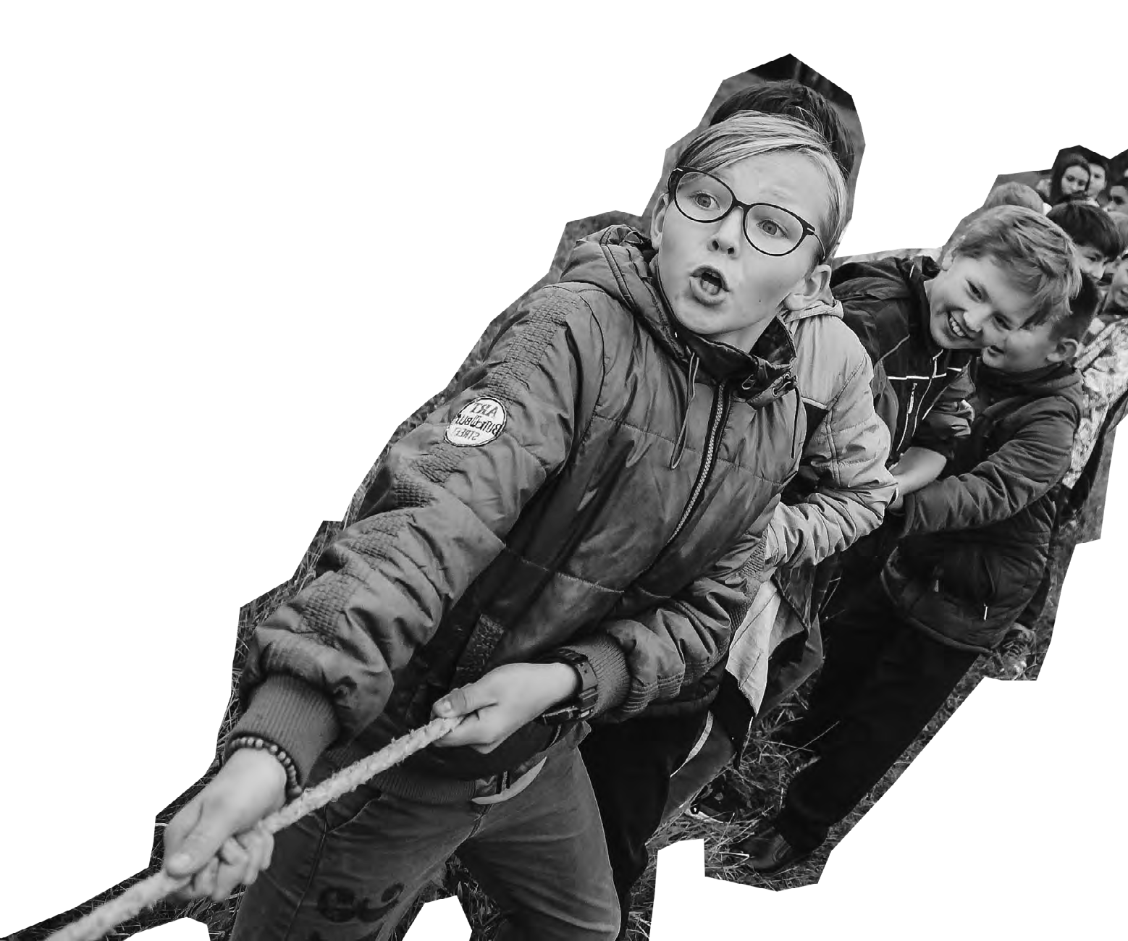
by
FURTHER INFORMATION
Deadline: 19th March 2026
Application Form: https://89d77627055430.uk.deputy.com/jobs#/
Application Process:
Stage 1 – Formal Interview (including Presentation or Practical)
Contact Information:
jobs@poweredbycan.org or 0121 530 8451
DBS and Reference
This role is subject to a clear enhanced DBS and satisfactory
Employment/Character references.
Please note we are currently using a new application system,
so if you face any technical difficulties please email jobs@poweredbycan.org

