Slide 1





CHARGING UP CHANGE!
Arts and Culture Producer - Apprenticeship
JOB DESCRIPTION & SPECIFICATION
DEADLINE: 27th June 2025

Slide 2
JOB SUMMARY
Arts and Culture Producer - Apprenticeship
Deadline: 27th June 2025
Application
ROLE | Arts & Culture Producer - Cultural Learning and Participation Officer Apprenticeship
REPORTING TO | Service Lead - Arts, Culture & Civic Change
SALARY | £7.55 per hour
HOURS | 40 hours per week
DURATION OF CONTRACT | 15 months
TIMESCALE | Immediate start
BASED | PBC HQ – West Bromwich
ROLES AVAILABLE | 1
SUMMARY | We are seeking an enthusiastic and motivated individual to join our team as a Cultural Learning and Participation Officer Apprentice. This is a unique opportunity to gain hands-on experience while studying towards a nationally recognised qualification. You’ll work closely with the team to design, deliver, and evaluate creative and educational programmes for diverse communities. The Cultural Learning and Participation Officer plays a vital role in promoting inclusive access to arts and culture through the development and delivery of engaging programmes and participation initiatives for children and young people across The Black Country. This role supports audience development, community engagement, and learning across diverse demographics.
by
Powered by CAN – Recruitment Pack| www.poweredbycan.org

Slide 3


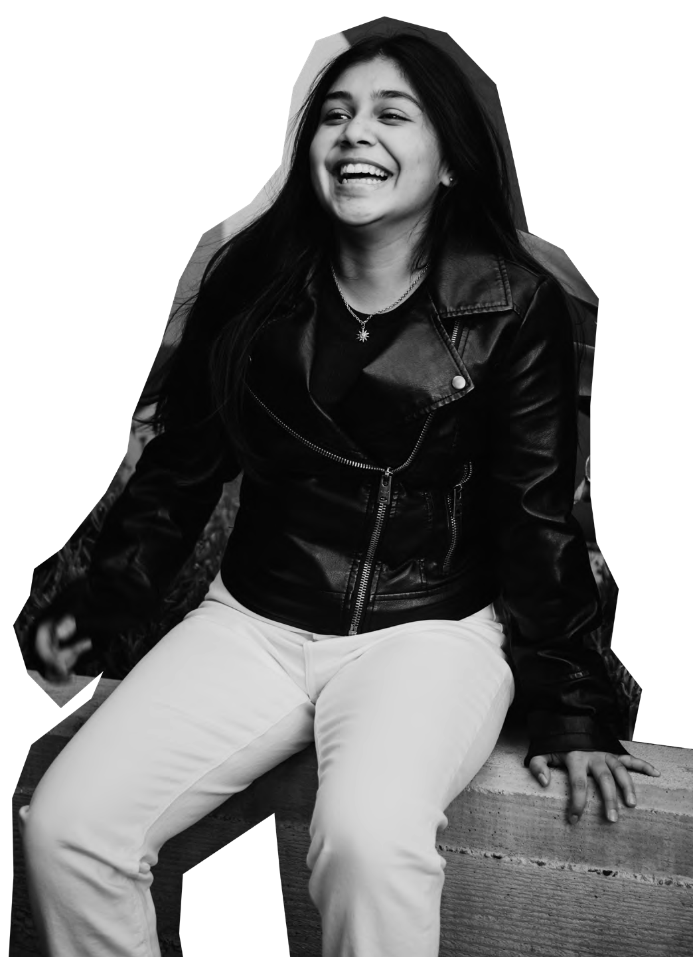

WHO
WE ARE
POWERING CHILDREN, YOUNG PEOPLE
& YOUNG ADULTS TO CHARGE UP CHANGE!
by
Powered by CAN – Recruitment Pack | www.poweredbycan.org

Slide 4

OUR STORY
How we got here….
Powered by CAN works with children, young people and young adults across the Black Country and the wider Midlands region. Powered by CAN was created, built and developed in Sandwell, and we want to empower young people from the region to feel the same pride and purpose for their community as we do.
Children, Young People & Young Adults are at the heart of everything we do, and we make sure that we always put them first by ensuring we always do the following:
Champion their rights to co-design, co-create and co-produce and make their voices heard.
Encourage leadership pathways for their views and voice to be present their local community.
Kick starting personal and professional development through a wider offer of experiences
We believe in providing opportunities for children, young people & young adults and we want to support them to thrive and contribute at every stage of their lives, for a fairer future.
HARNESSING YOUR…
POWER, POTENTIAL, PROGRESS
by
Powered by CAN – Recruitment Pack | www.poweredbycan.org

Slide 5


OUR MISSION
OUR VISION
How we can work together to make a difference…
We want to power up children, young people & young adults to live with pride, purpose and
prepared to make positive life choices.
How we can make the change…
Powering children, young people & young adults to lead the change they want to see through the delivery of services, opportunities & experiences to contribute at every stage of their lives, for a fairer future.
OUR VALUES
These are at the centre of everything we do…
CARE
CHALLENGE
COMMITMENT
COLLABORATION
CREATIVE
COMMUNITY
by
Powered by CAN – Recruitment Pack | www.poweredbycan.org

Slide 6





OUR SERVICES
Celebrating culture & civic responsibility through confidence, creativity & connecting with others…
Promoting positive lifestyles and empowering people through participation…
Navigating the narrative…
Taking the time to talk, tackle & transform into our true selves…
Always aiming high, aspiring to achieve & Accelerating your ambitions …
by
Powered by CAN – Recruitment Pack | www.poweredbycan.org

Slide 7


OUR OBJECTIVES
1
Pride of Place!
To develop collective understanding and knowledge on the identity of place to strength the services that are relevant to meet the needs of children, young people & young adults.
2
Positive Programmes & Principles!
To deliver ambitious and high quality opportunities and experiences for children, young people & young adults to strengthen best practice for the sector to meet soft, hard and transferable skills.
3
Powering Participants & People!
To build on the strengthens and needs of children, young people & young adults to thrive and be resilient into adulthood.
4
Pushing Performance & Policy!
To influence policy and investment to prioritise services for children, young people & young adults.
5
Playing our Part!
To ensure our workforce, volunteers, board, volunteers are dynamic, diverse and driven to be reputable, responsive and represent a rights based approach for people and place.
by
Powered by CAN – Recruitment Pack | www.poweredbycan.org

Slide 8


We are powered both by where we have come from and the positive energy moving forward with a ‘CAN’ do attitude.
We hope everyone we work with will be able to power up change!
CEO - Jerrel Jackson FRSA MIoD MA BA

Slide 9
DUTIES & RESPONSIBILITIES
Arts and Culture Producer - Apprenticeship
Program Development:
Design, plan, and deliver high-quality educational and participatory programmes across all age groups, aligning with organisational priorities and cultural values.
Community Engagement:
Build strong relationships with local communities, schools, and partner organisations to co-create relevant artistic and cultural experiences and encourage active participation.
Facilitation & Delivery:
Lead workshops, events, and outreach sessions in formal and informal settings, tailoring content to different learning styles and needs.
Project Management:
Coordinate logistics, budgets, evaluation, and administration for learning and participation projects, ensuring timely and effective delivery.
Monitoring & Evaluation:
Collect data and feedback to assess impact and improve future programming. Prepare reports and presentations for stakeholders and funders.
Collaboration:
Work closely with curatorial, programming, and marketing teams to ensure learning and participation are embedded throughout the organization.
Inclusion & Access:
Champion diversity, equality, and accessibility, removing barriers to engagement and ensuring inclusive practices in all activities.
by
Powered by CAN – Recruitment Pack | www.poweredbycan.org

Slide 10

DUTIES & RESPONSIBILITIES
Partnership and Networking
To work with Service Manager (Arts, Culture & Civic Change) and Programme & Projects Director to create partnerships with arts and culture organisations that can support children, young people and young adults in our projects.
To collaborate on forming connections with organisations locally, regionally and nationally that may either provide or encourage arts and culture for children, young people and young adults.
To develop relationships and partnerships across identified Priority Places/Leveling Up for Culture, with key stakeholders including local authorities, schools, health authorities and youth services.
To co-ordinate and oversee the work of freelance facilitators and artists to ensure the aims and standards of the projects are met to enable delivery.
Administration and Communication
Be responsible for completing all relevant paperwork in alignment with PbC’S policies and procedures.
To support the monitoring and evaluation of participant journey’s and programme impact for internal and external reporting.
To communicate effectively with PbC Development, Marketing and Income Generation team to align external communications and enable programme sustainability and growth according to participant need and demonstrating rating impact.
To provide development and learning to members of the Youth Management Board (YMB).
by
Powered by CAN – Recruitment Pack| www.poweredbycan.org

Slide 11
DUTIES & RESPONSIBILITIES
General Responsibilities
To represent the organisation within local and regional networks of supporters and stakeholders.
To participate in regular team meetings and supervision meetings.
Attend ideas meetings and contribute to discussions about the future of PbC.
To identify personal development and training opportunities for self and team & disseminate CDP & training opportunities to PbC staff.
To contribute ideas that may support the ongoing development of the organisation.
To contribute to the programming and administration of bespoke commissioned services.
To ensure confidentiality within the organisation at all times.
To participate in activities which fall outside of normal working hours as required, e.g. Training, Staff Meetings, Recruitment/Engagement events, fundraising events, etc.
To undertake such other duties and responsibilities of an equivalent nature as may be determined from time to time by SLT.
Equal Opportunities and Safeguarding
To work within the organisation's safeguarding and equal opportunities policies to ensure allocated staff and practitioners line managed by the role work within the organisation's safeguarding and equal opportunities policies.
To undertake relevant risk assessments before undertaking events/projects/activities for which the role has direct responsibility.
by
Powered by CAN – Recruitment Pack| www.poweredbycan.org

Slide 12

PERSON SPECIFICATION
Arts & Culture Producer
Essential
A keen and active interest in the vision and purpose of PbC, with a working knowledge of Black Country and surrounding areas (including knowledge of marginalised communities).
To respond to new challenges with agility and a proactive approach with an understanding of equal opportunities and cultural diversity issues in the delivery of our services, both internally and externally.
A keen interest in multi disciplinary arts
Drive towards Youth Voice / Collaboration/Co-creation
Interest towards motivating and empower children, young people & young adults
A positive attitude with a high level of self-motivation and ability to work on your own initiative.
Working knowledge of relevant software packages (Microsoft Office Suite, Google).
Knowledge / Interest in a diverse range of arts, cultural, education and community sectors.
Desirable
A degree or equivalent qualification in the Cultural, Creative, Education and Youth sectors.
Previous experience of working with children, young people and young adults.
Experience in a similar role in the Cultural, Creative, Education and Youth sectors.
by
Powered by CAN – Recruitment Pack| www.poweredbycan.org

Slide 13

by
FURTHER INFORMATION
Deadline: 27th April 2025
Application Form: https://89d77627055430.uk.deputy.com/jobs#/
Application Process:
Formal Interview
Contact Information:
jobs@poweredbycan.org or 0121 530 8451
DBS and Reference
This role is subject to a clear enhanced DBS and satisfactory
Employment/Character references.
Please note we are currently using a new application system,
so if you face any technical difficulties please email jobs@poweredbycan.org

