Slide 1
CHARGING UP CHANGE!
Creative Producer - Arts & Culture
JOB DESCRIPTION & SPECIFICATION
DEADLINE: Friday 25th April 2025

Slide 2
JOB SUMMARY
Creative Producer - Arts & Culture
Deadline: Friday 25th April 2025
Application https://poweredbycan.uk.deputy.com/jobs#/2utTXXIj6LW4BDMmWrBcoEw9Api
ROLE | Creative Producer - Arts & Culture
REPORTING TO | Service Lead - Arts, Culture & Civic Change
SALARY | £25,605 per annum pro rata
HOURS | 20 hours per week (Including weekend work)
DURATION OF CONTRACT | 31st March 2026
TIMESCALE | Immediate start
BASED | PBC HQ – West Bromwich
ROLES AVAILABLE | 1
SUMMARY | Powered By CAN are seeking a passionate and dynamic Creative Producer to develop a youth theatre group for 14-18-year-olds. This role is perfect for someone with a background in production, facilitation, and youth engagement who is eager to create inspiring and high-quality performance experiences for young people. This might look like; Developing the artistic vision and programming of the youth group. Planning, producing, and delivering projects, workshops, and performances with young people. Facilitating creative sessions that build skills in acting, devising, writing, and performance. Collaborating with directors, writers, designers, and other artists to support high-quality productions. Supporting young people in their creative development, ensuring an inclusive and supportive environment.
by
Powered by CAN – Recruitment Pack| www.poweredbycan.org

Slide 3
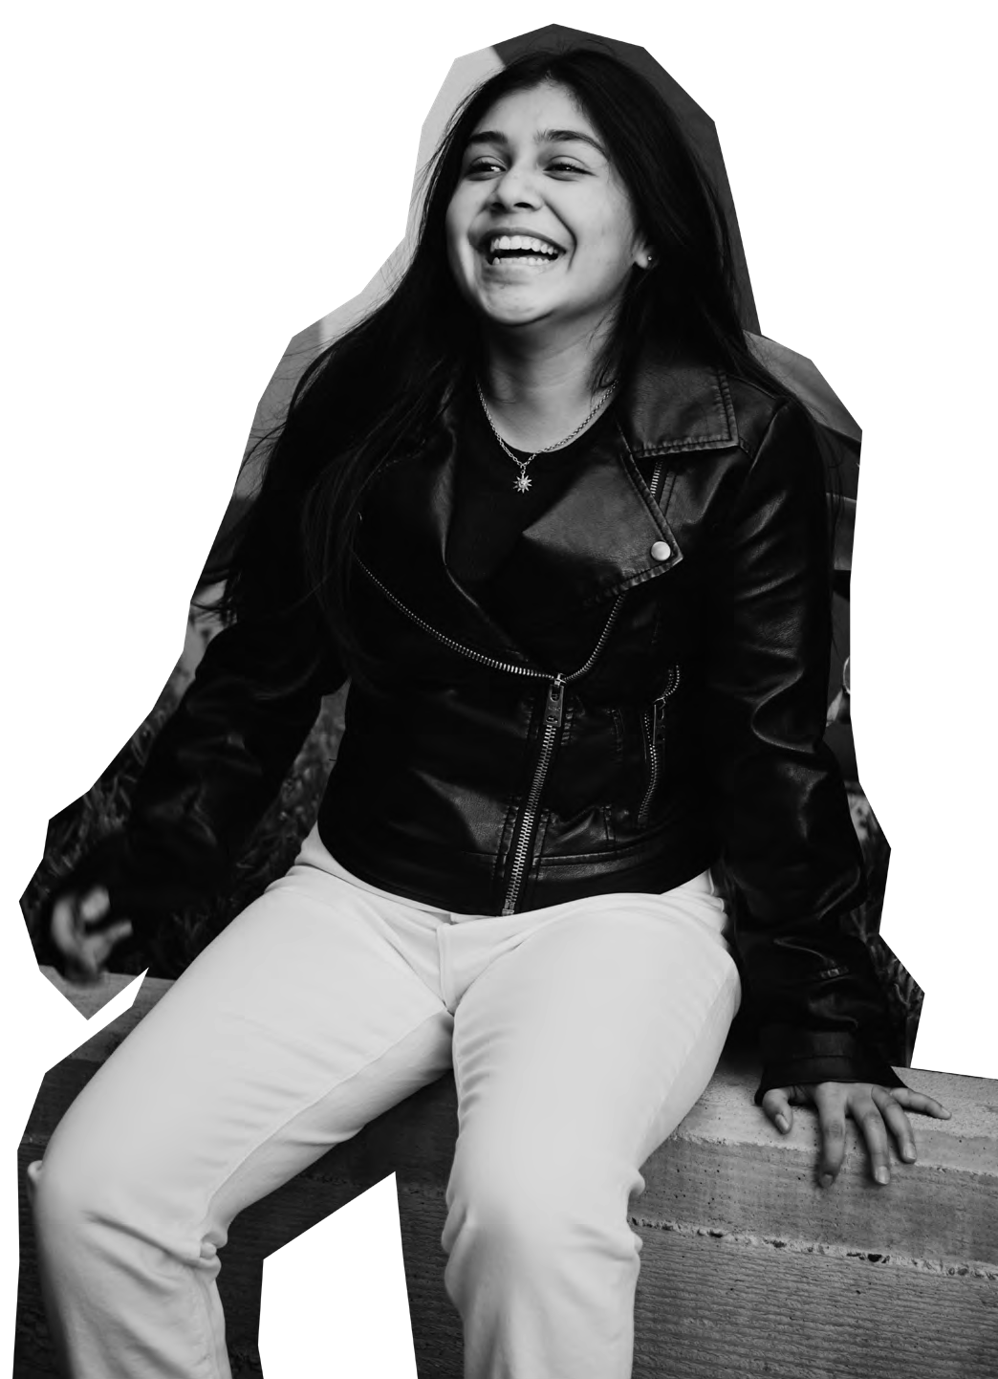
WHO
WE ARE
POWERING CHILDREN, YOUNG PEOPLE
& YOUNG ADULTS TO CHARGE UP CHANGE!
by
Powered by CAN – Recruitment Pack | www.poweredbycan.org

Slide 4
OUR STORY
How we got here….
Powered by CAN works with children, young people and young adults across the Black Country and the wider Midlands region. Powered by CAN was created, built and developed in Sandwell, and we want to empower young people from the region to feel the same pride and purpose for their community as we do.
Children, Young People & Young Adults are at the heart of everything we do, and we make sure that we always put them first by ensuring we always do the following:
Champion their rights to co-design, co-create and co-produce and make their voices heard.
Encourage leadership pathways for their views and voice to be present their local community.
Kick starting personal and professional development through a wider offer of experiences
We believe in providing opportunities for children, young people & young adults and we want to support them to thrive and contribute at every stage of their lives, for a fairer future.
HARNESSING YOUR…
POWER, POTENTIAL, PROGRESS
by
Powered by CAN – Recruitment Pack | www.poweredbycan.org

Slide 5
OUR MISSION
OUR VISION
How we can work together to make a difference…
We want to power up children, young people & young adults to live with pride, purpose and
prepared to make positive life choices.
How we can make the change…
Powering children, young people & young adults to lead the change they want to see through the delivery of services, opportunities & experiences to contribute at every stage of their lives, for a fairer future.
OUR VALUES
These are at the centre of everything we do…
CARE
CHALLENGE
COMMITMENT
COLLABORATION
CREATIVE
COMMUNITY
by
Powered by CAN – Recruitment Pack | www.poweredbycan.org

Slide 6
OUR SERVICES
Celebrating culture & civic responsibility through confidence, creativity & connecting with others…
Promoting positive lifestyles and empowering people through participation…
Navigating the narrative…
Taking the time to talk, tackle & transform into our true selves…
Always aiming high, aspiring to achieve & Accelerating your ambitions …
by
Powered by CAN – Recruitment Pack | www.poweredbycan.org

Slide 7
OUR OBJECTIVES
1
Pride of Place!
To develop collective understanding and knowledge on the identity of place to strength the services that are relevant to meet the needs of children, young people & young adults.
2
Positive Programmes & Principles!
To deliver ambitious and high quality opportunities and experiences for children, young people & young adults to strengthen best practice for the sector to meet soft, hard and transferable skills.
3
Powering Participants & People!
To build on the strengthens and needs of children, young people & young adults to thrive and be resilient into adulthood.
4
Pushing Performance & Policy!
To influence policy and investment to prioritise services for children, young people & young adults.
5
Playing our Part!
To ensure our workforce, volunteers, board, volunteers are dynamic, diverse and driven to be reputable, responsive and represent a rights based approach for people and place.
by
Powered by CAN – Recruitment Pack | www.poweredbycan.org

Slide 8
We are powered both by where we have come from and the positive energy moving forward with a ‘CAN’ do attitude.
We hope everyone we work with will be able to power up change!
CEO - Jerrel Jackson FRSA MIoD MA BA

Slide 9
DUTIES & RESPONSIBILITIES
Creative Producer - Arts & Culture
Place Making and Place Shaping
To have knowledge of and drive Arts Council England’s Investment Principles/Outcomes & Let’s Create Strategy (including other governing/arms length organisations) in collaboration with the Management Team (MT) and to be appointed as one of our Inclusivity and Relevance champions for our Arts Council England’s Investment Principles.
To liaise with children, young people and young adults within the community making them forefront of any decisions for a place based approach so that they benefit from increased access to arts and culture.
To design a training programme across the Black Country and surrounding areas.
To develop mechanisms for sharing the learning from consultations to influence project development and policy in the local area.
by
Powered by CAN – Recruitment Pack | www.poweredbycan.org

Slide 10
DUTIES & RESPONSIBILITIES
Creative Producer - Arts & Culture
Community and Civic Change Programming
To manage, devise and implement outreach strategies, proactively seeking out community led arts, culture, educational and creative initiatives to inspire, engage and create impact in communities.
To lead on researching, liaising with organisations locally, regionally and nationally that can provide arts and culture opportunities.
To develop strategies for civic change and proactively work in collaboration with place based ecologies to look at change making and cultural leadership.
To co-create with the Next Generation Now Team to devise youth consultation events, taking a creative approach to engage and capture the views of children, young people and young adults to oversee a range of youth-led projects within the community (including those inside and outside of schools).
by
Powered by CAN – Recruitment Pack | www.poweredbycan.org

Slide 11
DUTIES & RESPONSIBILITIES
Partnership and Networking
To co-lead with Service Manager (Arts, Culture & Civic Change) and Programme & Projects Director to create partnerships with arts and culture organisations that can support children, young people and young adults in our projects.
To collaborate on forming connections with organisations locally, regionally and nationally that may either provide or encourage arts and culture for children, young people and young adults.
To develop relationships and partnerships across identified Priority Places/Leveling Up for Culture, with key stakeholders including local authorities, schools, health authorities and youth services.
To co-ordinate and oversee the work of freelance facilitators and artists to ensure the aims and standards of the projects are met to enable delivery.
Administration and Communication
Be responsible for completing all relevant paperwork in alignment with PbC’S policies and procedures.
To support the monitoring and evaluation of participant journey’s and programme impact for internal and external reporting.
To communicate effectively with PbC Development, Marketing and Income Generation team to align external communications and enable programme sustainability and growth according to participant need and demonstrating rating impact.
To provide development and learning to members of the Youth Management Board (YMB).
by
Powered by CAN – Recruitment Pack| www.poweredbycan.org

Slide 12
DUTIES & RESPONSIBILITIES
General Responsibilities
To represent the organisation within local and regional networks of supporters and stakeholders.
To participate in regular team meetings and supervision meetings.
Attend ideas meetings and contribute to discussions about the future of PbC.
To identify personal development and training opportunities for self and team & disseminate CDP & training opportunities to PbC staff.
To contribute ideas that may support the ongoing development of the organisation.
To contribute to the programming and administration of bespoke commissioned services.
To ensure confidentiality within the organisation at all times.
To participate in activities which fall outside of normal working hours as required, e.g. Training, Staff Meetings, Recruitment/Engagement events, fundraising events, etc.
To undertake such other duties and responsibilities of an equivalent nature as may be determined from time to time by SLT.
Equal Opportunities and Safeguarding
To work within the organisation's safeguarding and equal opportunities policies to ensure allocated staff and practitioners line managed by the role work within the organisation's safeguarding and equal opportunities policies.
To undertake relevant risk assessments before undertaking events/projects/activities for which the role has direct responsibility.
by
Powered by CAN – Recruitment Pack| www.poweredbycan.org

Slide 13
PERSON SPECIFICATION
Creative Producer - Arts & Culture
Essential
A minimum of 3-5 years in a similar role in the Cultural, Creative, Education and Youth sectors.
A keen and active interest in the vision and purpose of PbC, with a working knowledge of Black Country and surrounding areas (including knowledge of marginalised communities).
To respond to new challenges with agility and a proactive approach with an understanding of equal opportunities and cultural diversity issues in the delivery of our services, both internally and externally.
To have an awareness of ACE’s Let’s Create and Investment Principles and Outcomes.
A positive attitude with a high level of self-motivation and ability to work on your own initiative.
Working knowledge of relevant software packages (Microsoft Office Suite, Google).
Knowledge of arts, cultural, education and community sectors.
Desirable
A degree or equivalent qualification in the Cultural, Creative, Education and Youth sectors.
Knowledge of youth work and/or previous experience of working within a youth-led organisation.
by
Powered by CAN – Recruitment Pack| www.poweredbycan.org

Slide 14
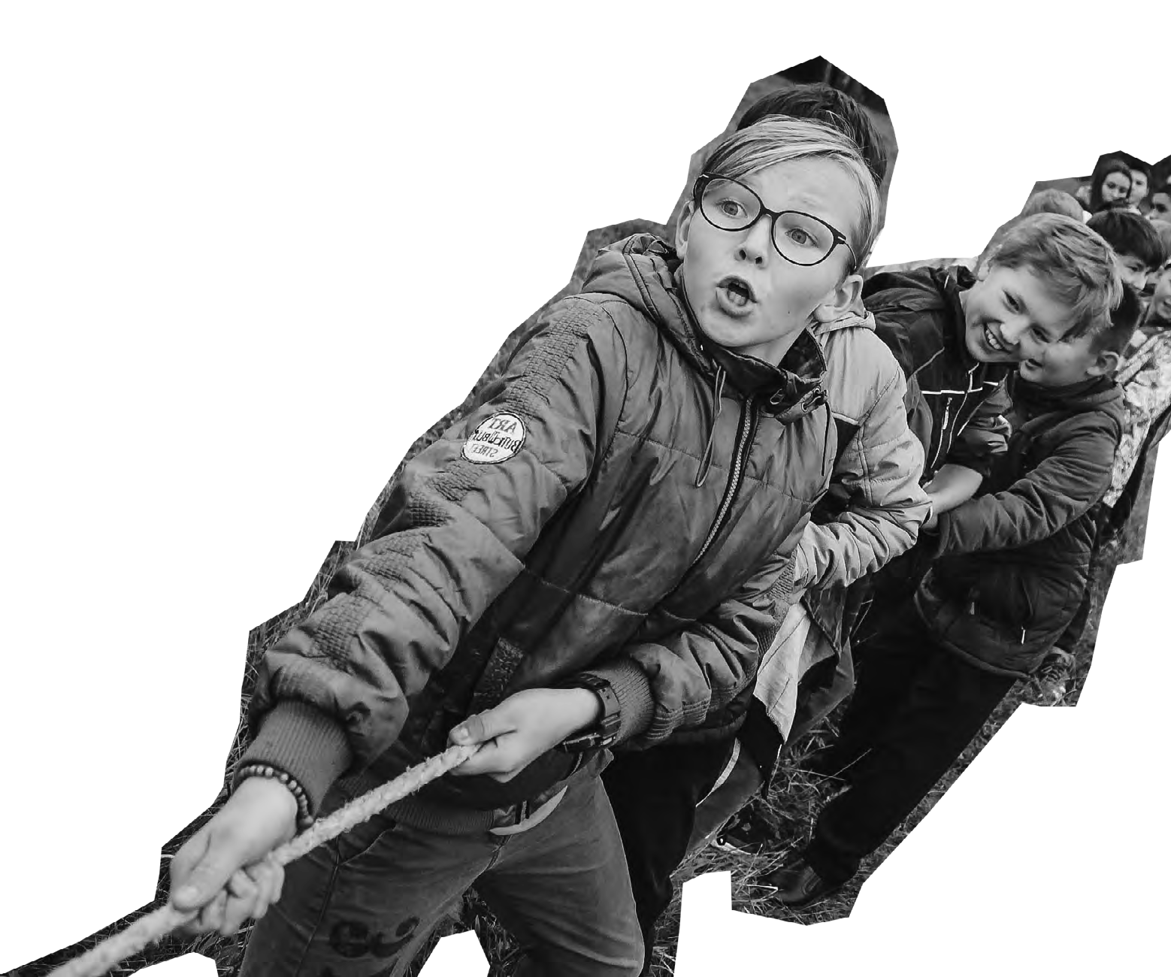
by
FURTHER INFORMATION
Deadline: Friday 25th April 2025
Application Form: https://89d77627055430.uk.deputy.com/jobs#/
Application Process:
Formal Interview
Contact Information:
jobs@poweredbycan.org or 0121 530 8451
DBS and Reference
This role is subject to a clear enhanced DBS and satisfactory
Employment/Character references.
Please note we are currently using a new application system,
so if you face any technical difficulties please email jobs@poweredbycan.org

